Slide 1
Marketing Strategy for an Education Technology Company
April 14th, 2024

Slide 2
Agenda
1. Competitor Analysis
5. Marketing Research
2. SWOT Analysis
6. Promotional Strategy
3. Industry Analysis
7. Primary Research
4. Porter’s Five Forces Analysis
8. Customer Persona
FACES Consulting

Slide 3
Competitor Analysis
Section #1

Slide 4






Leveraging noredink's Position: A Blueprint for Geni’s Competitive Advantage
Company overview
Advantages
Remarkable Traits
Products: Web-based learning platform to help student
Customers: >60% of US school districts
Revenue: 59 M (Series B funding)
Investors: 13
Customized Learning: Individual student’s preference
Teacher Support: lesson plans, progress tracking, and feedback tools
Patents: 2
ELA for 3-12 grade
Self & peer review feature
Customer Engagement
Key Takeaways
Attend conferences
Host webinars to promote products
Media cover by different news channels
Active in social media
Marketing strategy: Digital marketing, social media campaigns, influencer partnerships to reach a broader audience
Personalized Educational Materials: Emphasize commitment to tailored learning , resonating with educators and students seeking customized resources
Disadvantages
Student's information is used to track and target advertisements on third-party websites
Doesn’t support android and iphone
Customers cannot report abuse or cyberbullying
Technology Integration
Applications: Google Classroom, Google Workspace, Canvas
Platforms supported: Web
The effectiveness of personalized materials of noredink prompts Geni Zone to enhance customization, catering better to diverse student needs
noredink; YahooFinance; cbinsights; venturebeat,com; crunchbase.com, businesswire.com Linkdln; Weebly
Notes:
Sagnika

Slide 5








Assessing the competitive landscape by performing competitor analysis on Flint, Inc.
Company Overview
Flint is an AI platform designed specifically for schools, focusing on enhancing learning experiences while safeguarding student data
Market Positioning
Technology Integration
Opportunities for Geni Zone
Strong focus on K-12 with AI-driven personalization and security​​​​
Automated tutoring systems
Adaptive assessment tools
Ethical AI use, ensuring safe access for students
Specialize in Untapped Educational Segments: Capitalizing on areas Flint may overlook, such as vocational training or higher education
Advance Technological Integration: Exploring next-gen tech like AR/VR could redefine learning experiences, offering Geni Zone a distinctive market position
Prioritize Data Security and Ethical AI: Establishing a reputation for prioritizing data privacy could attract institutions wary of digital risks
Diversify Partnership and Sales Strategies: Collaborating with a broader range of partners could enhance product offerings and market reach
Engage with User Community: A stronger focus on user feedback and community building could refine product development and customer satisfaction
Product Offerings
Sales Channels
Offers customizable AI assignments, feedback, and tutoring tailored for K-12
Direct outreach to schools and districts
Online sales through their website SEO, social media, and email
Partnerships
Customer Engagement Strategies
Synapse School
The Westminster School
The Episcopal Academy
Personalized support and training for educators
Webinars on product use and workshops
Flint's AI-driven edge in K-12 underscores the need for Geni Zone to elevate data protection and accessibility, ensuring competitive relevance in the evolving EdTech landscape
Flint, LinkedIn
Notes:
Stanley

Slide 6




Identifying Fetchy’s market position enables Geni to gain a competitive edge
Unique features
Can gift a subscription to a teacher or user
Tips and tricks to improve workflow
Values
Slogan: “Ready, Fetch, Done.” Save 2.5 hours/day with Fetchy
Mission: Paving a new path for education
Differentiating factors: Helping educators generate results(lessons, assignment, etc) without the needs to learn commands or prompts
Overview
$10 per month / $99 per year
Offering bulk deals for schools, $7 per member for more than 10 signups
Founded in 2020
Categories Covered by Fetchy products- ELA, Math, Arts, Science & STEM, Social Studies & History, Multimedia, Testing & Review, Teacher Training Materials
Offer up to 50 specific “tools” for teachers to use to generate content and assignments
Tools include story generator, assignment generator and creator, resource identifier and academic advising
Cost
Communication
Help Center: To deal with technical issues; either textual guide or video tutorials
Feedback: Comments of many users showing on the website, and FAQs show transparency
Educators from preschool to university levels
Parents interested in homeschooling
Target Market
Takeaway
Advantages: Strong help center and strong GUI make the tool easy to use and makes fixing problems easier, FAQs also make fixing bugs and problems easier
Disadvantages:
Do not have any existing partnerships with other Ed-Tech companies or organizations
Fetchy's AI tool is priced higher than competitors such as Geni
Company Blog
Limited presence on X and Instagram, larger presence on Facebook
Social Media & Marketing
Geni Zone should consider stating benefits over other tools, posting FAQs and contact information for help, and making the product easy to understand for new users
Fetchy, RetReport
Notes:
Raghav

Slide 7

Evaluating the operation mode of FACTS helps Geni Zone benchmark and improve its marketing strategy
Market Positioning and Overall Portraits of FACTS
International business: Lincoln, Nebraska
Large scale: Cooperate with 11,500 schools and 3,000,000+ students currently
Integrated service for K-12 schools and families
G suite including google classroom
Active directory provided by Microsoft
29 integration partners: Apple School Manager, Canvas, Blackbaud, Clever, Cornerstone, EduConnect
Admission solution: Website; Mobile APP
Student information system: Schedule; Communication
Education services: Training for teachers
Financial management: Tuition payment; Grant & Aid; Fundraising
16 affiliation partners: Alliance for Catholic Education, Christian Schools International, Catholic Virtual, DME Partners, ACSI, AISNE, ISACS, MISBO
6 referral partners: Breakwater Accounting, Class Intercom, SchoolAdmin, Emerging Technologies, Xceed Anywhere, Dewar
Social media: Facebook, X, LinkedIn
Blogs of useful tip to attract potential customer
Email promotion: Get contact information of potential customer from providing demo
Teacher Innovation Award related to corporate social responsibility
Conference to meet network need for customer
Webinar to promote product and contact customer
Feasibility Analysis of Strategic Cooperation between Geni Zone and FACTS
FACTS
Advantage: Integrated ecosystem of products
Geni
Zone
Advantage: High leverage of AI technology
Partnership
Enhance education service by focusing on learning material for student
Provide value-added service: Webpage redesign; Online customer service
Contact with regional representative of school partnership development and other general leaders by email or phone
Disadvantage: Slow response to customers
Disadvantage: Insufficient brand awareness
FACTS offers streamlined solutions for administration in schools, and Geni Zone can contact by email or phone to show the common mission as an affiliation partner in the business line of education services
FACTS; LinkedIn
Notes:
Xiaolei

Slide 8
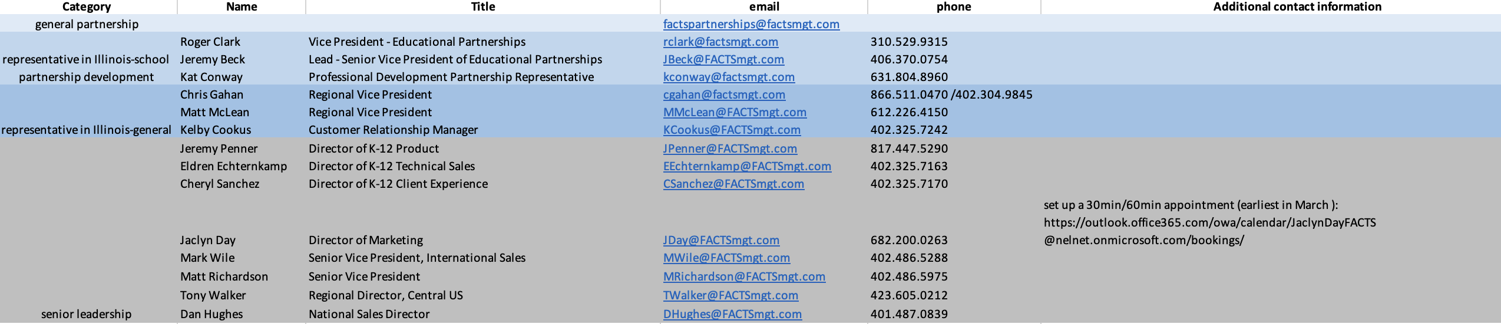
Appendix – FACTS Contact List

Slide 9
SWOT Analysis
Section #2

Slide 10


Conducting SWOT Analysis helps Geni Zone fit in market trend by preserving its advantages and improving its weaknesses
Strength
Weakness
Opportunity
Threat
Takeaways
Resource Availability
Data Limitation
Market Trends
Regulatory Changes
Improve after-school education products to develop to-C customer base to utilize long-tail effect
Improve introduction video by adding soft background music or use Geni fox as a host to interview school users
Conduct research with data support to show positive correlation between using Geni and improving students’ learning enthusiasm and show this as a testimonials on the website to inform target audience
Enhance the concept of Teacher-Student-Machine Trinity
Mutual learning and helping technology community(Open-source in Illinois)
Potential funding resource (Department of Education Grant(SBIR 1B))
Primary learning and teaching database needed to train model
Depend on third-party technical platform
Desire of customized education and increase number of home school bring prospects for online education (2.7M student users)
Investment of AI education is still at angel stage
Double-Decrease Policy makes obstacles for assignment creation product
Integrity of academic may restrict the AI use on education
Differentiation Strategy
Consumer Experience
Technology Advancements
Consumer Behavior
Socially responsible brand image(A Courageous Hope)
Competitive pricing strategy($5/month, half of Fetchy)
Arouse interest to K-8 students(painting with bright theme color, game set design, interactive chat box)
Introduction video lacks storyline of brand commission
No clear inclusion of products in advertising materials
No draw pen to take notes in storybook
Inconsistent logo and default user character
ChatGPT, AI Generated Content(AIGC), MathGPT arouse people’s attention(5 times increase on Google Search Trends)
America’s computational power index (CPI) is 82 (globally rank 1st)
AI can’t understand complicated emotion of users, thus lack accuracy in some aspects
Heavily rely on electronic equipment, causing parent concern (70% US parents against kids under 12 using electronic devices)
Geni could take advantage of favorable market expectations for AI education sector, strengthen its brand image by creative and innovative design to spread the value of education equality
Forbes; Geni Zone; Iresearch; Pew Research Center
Notes:
Xiaolei
Forbes: https://www.forbes.com/sites/michaelhorn/2024/02/13/6-trends-to-watch-in-k-12-schools-in-2024/?sh=40e17da5662f
Geni Zone: https://geni.zone/
Iresearch: https://mp.weixin.qq.com/s/eKKZR8zbl6BszR7hBrtMQA
Pew Research Center: https://www.pewresearch.org/internet/2020/07/28/parenting-approaches-and-concerns-related-to-digital-devices/

Slide 11



Analyzing and providing solutions for Geni’s current constraints with regards to the target market
Pricing Structure
Product Offerings
Brochure can be improved by to show a sample prompt and then the assignment that was generated; use brochure to capitalize on Geni’s main selling points: the tool’s ease of use and the high accuracy of the results generated
Diversification in the number of subjects offered or applications of the product; many competitors, such as Fetchy and FACTS, offer multiple different subjects and tools for teachers to use in a variety of scenarios; the EdTech industry has a predicted annual growth rate of 26.5% from 2024-2030, with STEM subjects accounting for over 40% of the market
Package Deals (priced at $4 or less) can incentivize the purchases for groups of educators​​ with more than 10 new subscribers; reduces Geni’s customer acquisition cost through word-of-mouth marketing
Period based pricing, where the subscription is priced at $5 per month for a single month plan, with incrementing discounts as the number of months increases (such as $4 per month for 3 months); reduces churn and allows Geni to form a strong long-term customer base
Free Trials can help market towards individual tutors and home educators by giving them a buffer period before making a purchase​​; to optimize the conversion rate of free trial users in subscription services, the trial should be provided for a period of 2 weeks at most (45% for 2 weeks versus 31% for 3 weeks)
Creating a company history or blog page for the Geni website to build trust in client relationships and reinforce customer engagement
Leveraging social media and advertisements through Facebook and Instagram; Kranse Institute, an EdTech company, had a 22% increase in enrollments after a short $500 Facebook video ad campaign
Creating 2 separate videos for the product; primary video to market to prospective subscribers, watermark with Geni logo, include Geni URL and keep video concise; secondary video to demonstrate the tool to new subscribers, in lieu of travelling to partner schools and explaining the product
Marketing and Media
Geni could work to improve their overall product through strategic pricing, captivating brochures, impactful marketing initiatives, and eventually expansion to different subjects
ChatterBuzz; Cognitivemarketresearch; Grandviewresearch; Insightus; WebFX
Notes:
Raghav

Slide 12
Industry Analysis
Section #3

Slide 13



Defining the current educational technology industry and the trends Geni Zone should focus on
Industry Overview
Industry Trends
13.6%
CAGR 2023-2030
$ 142.37 Billion
Market Size in 2023
Technology Advancements
Mobile learning: pandemic affects people to keep mobile learning as an option, 87% of K-12 educators say their tech skills improved during the pandemic
Gamification: an experiment shows that students participate in a virtual reading ranking game achieved high scores tend to keep the habit of reading online
Adaptive learning: an experiment shows modifying the tasks based on students’ personalities motivates passions
Key Players
Customers
Competitors
Duolingo, Coursera, Schoology, Fetchy, NoRedInk, FACTS, Flint
Potential Partners
Collaboration with hardware & software companies
Google's G Suite & Chromebooks: Schools that deploy these tools are more likely to have students be familiar with the tools they will use in workforce
Schools and parents are the buyers, while teachers and students are the main users
Key Takeaway
Market Demand
Pedagogical Innovations
Industry has an increasing demand due to pandemic
New technologies motivate students’ interests to learn more actively
Collaboration with other technology companies as complementation to reach larger profits
EdTech usage in schools has increased 99% since 2020
60% of K-12 teachers plan on continuing to give online assignments after the pandemic
Gamification: games incorporated with learning tasks; VR/AR in future
Digital content: more accessible (Ex. visually impaired students can leave voice notes)
Live Tutoring & Screencast: flexible time management(Ex. Save time from transportation; step-by-step visualized solution)
Current educational technology industry is growing prospectively with advanced techniques to motivate students’ interests; Geni Zone could collaborate with hardware & software companies
Ebsco; Exploding Topics; Forbes Tech Council; Grandview Research; Hurix Digital; Research Gate
Notes:
Coco
1. https://web-p-ebscohost-com.proxy2.library.illinois.edu/ehost/pdfviewer/pdfviewer?vid=6&sid=e1297914-fd89-4d1c-9740-796a58969645%40redis
2. https://web-p-ebscohost-com.proxy2.library.illinois.edu/ehost/detail/detail?vid=5&sid=bfd30aad-5219-461e-ba0c-b4f8fe5358a3%40redis&bdata=JnNpdGU9ZWhvc3QtbGl2ZSZzY29wZT1zaXRl#AN=160258217&db=bsu
3. https://explodingtopics.com/blog/edtech-stats
4. https://www.forbes.com/sites/forbestechcouncil/2024/02/28/three-ways-your-organization-could-be-susceptible-to-ransomware-attacks/?sh=1d43441976b3
5. https://www.hurix.com/top-10-edtech-companies-in-the-united-states/
6. https://www.researchgate.net/publication/356716897_Adaptive_gamification_in_E-learning_A_literature_review_and_future_challenges

Slide 14





Identifying potential industry to understand the market dynamics for Geni Zone's operation
Industry Analysis
Needs and Challenges
Submarkets: Urbana, Homer, St Joseph, Mahomet
63 Public schools & 27 Private schools
5 catholic schools. All are private schools
Challenges: Boredome and mundane nature of teaching
No variety in assessment tests
Champaign County
Potential Customers: 24,671 students have enrolled in public schools and 3850 in private schools
87% of all K-12 students are educated in public schools
Needs: A personalized learning environment fosters student interests, connections between learning experiences, and collaborative project design
Data & digital literacy
Potential Customers
Challenges for Geni Zone
Opportunities for Geni Zone
Champaign Community Unified School District: 20 schools and 10,277 students. 33.2% of students are economically disadvantaged
Elementary Schools:13, Middle Schools: 3, High schools: 2
Student/ Teacher: 13:1
Reduce response time: Ability to respond, 24/7 meaning consumers are no longer restricted to business hours and can expect a much quicker response
Use survey data from schools to personalize customer experience
Boost communicability: Consumers expect transparent and consistent communication, and that questions and problems will be quickly resolved
Competitive pressure: iSpring Suite, Articulate 360, noredInk, HubSpot Academy
Mobile-ready and adaptive, free trial for 30days immediate feedback
Regulatory pressure: Protection of data privacy and considering an age limit of 13 for use in the classroom
Shifts in consumer expectations: Behavior shifted dramatically during the pandemic, as customers favored a ‘back-to-basics’ approach by businesses
The educational technology industry presents a promising landscape for Geni Zone to innovate, expand its reach, and make a meaningful impact on students' learning outcomes
Champaigncountynewz; Datatobuz; Usnews

Slide 15







Performing market research on the international private education market for possible countries to expand towards
Industry Overview
Statistics
Key Takeaways
United Kingdom
Canada
Singapore
554,316 pupils currently attending Independent Schools in the UK, representing around 5.9% of all school attendees
The UK has 1,395 independent schools, which include boys-only, girls-only, and co-educational institutions
The number of students enrolled in higher education and tertiary programs in PEIs(private educational institution) dropped by approximately 50%, or about 57,130 students, from 2008 to 2020
PEIs in Singapore are facing challenges such as the need to differentiate their program offerings, particularly in non-STEM courses like business management
$280 BN
(2022)
$53.1 BN
(2023)
$14.5 BN
(2021)
CAGR ~15%
CAGR ~10%
CAGR ~20%
$510 BN
(projected 2032)
$94.07 BN
(projected 2027)
$78.1 BN
(projected 2030)
Next Steps
Expansion Considerations
Recommendations
The importance of strategic partnerships for entering new markets​​ are vital
The use of gamification and technology in classrooms is a growing trend, an opportunity for Geni Zone to integrate its offerings with these innovative educational approaches​​
Capitalize on the rapidly growing education market in Singapore (20%) and UK (15%)
Align Geni Zone’s product development with the increasing demand for EdTech solutions in the UK market
Geni Zone's innovative EdTech solutions can capitalize on the dynamic shifts and varying demands in global private education sectors to secure a competitive edge
CNA, Eduvalue, Polaris, Statista

Slide 16
Porter's Five Forces Analysis
Section #4

Slide 17
Analyzing the U.S. public school market using Porter’s Five Forces to help Geni Zone better understand the local market
Threat of Substitutes
Overview
Power of Suppliers
Beyond other AI solutions, consider traditional and emerging educational tools as potential substitutes
The product should demonstrate clear advantages in effectiveness and usability
Illinois has over 3800 public schools
These schools serve more than 2 million students
Annual state expenditure on public education is around $15,000 per pupil
Significant per-pupil expenditure demonstrates schools' dependency on suppliers for quality resources
Dependence on tech and data providers could influence your product's cost and quality
Strategic partnerships are essential
Threat of New Entrants
Industry Analysis
Power of Buyers
Regulatory and financial barriers makes the market to have low barriers to entry
Expect continuous innovation from competitors due to rapid technological advancements
Venture Capital, new companies can gain necessary funding to compete effectively
High competition: high numbers indicate diverse options for students
AI solution must offer unique value to stand out in Illinois' crowded market
Some of unique solutions can include Carnegie Learning's MATHia and Tailord support
Multiple schooling options enhance parents' and students' choices, pushing schools to improve offerings and engagement strategies
Schools and districts have varied needs and budget constraint
Customizable and scalable AI solutions can increase appeal
AI in Illinois' EdTech needs innovative, adaptable solutions to make a significant impact in a competitive, evolving educational sector
Illinois State Board of Education
Notes:
Stanley

Slide 18



Leveraging Porter’s Five Force Model helps Geni Zone prioritize strategic plans for private schools in the long run
Threat of New Entrants
VS
Fund requirement: Needs sufficient fund to provide low price
Technological barrier: 12 important patents in education software in the recent decade
US private schools:
24% of total
Global private schools:
20% of total
Bargaining Power of Suppliers
Threat of Substitution
Bargaining Power of Buyers
Supplier size: Highly fragmented without monopoly
Switching cost: Easy to replace current supplier due to fast-speed innovation and technology advancement
Market trend: More private schools incorporate compatible digital learning software with introduction of educational technology
Value for money: Digital learning materials are cost-effective with reusable feature rather than paper
Population size: Large customer base
Disposal income: High income household with low price sensitivity to educational expense
Threat of Rivalry
Key Takeaways
Industry growth: Fast speed with fierce competition in price-cutting strategy
Market share: Lots of giants with differentiated products and services
With high threat of rivalry, Geni Zone should increase spending on innovation or cooperation
With low bargaining power of stakeholders, Geni Zone could tailor its customized products with higher price in the future
Geni Zone could use market penetration strategy with AR/VR technology to expand market share, enhance customer loyalty and maintain long-term cooperating relationship
BCC Research; LinkedIn; National Center for Education Statistics; The World Bank
Notes:
Xiaolei
1 BCC Research: https://academic-bccresearch-com.proxy2.library.illinois.edu/market-research/instrumentation-and-sensors/educational-equipment-and-software-global-markets.html
2 LinkedIn: https://www.linkedin.com/learning/strategic-planning-case-studies/define-the-strategic-environment?resume=false&u=43607124
3 National Center for Education Statistics:https://nces.ed.gov/programs/digest/d21/tables/dt21_205.40.asp
4 The World Bank: https://data.worldbank.org/indicator/SE.SEC.PRIV.ZS?most_recent_value_desc=true

Slide 19
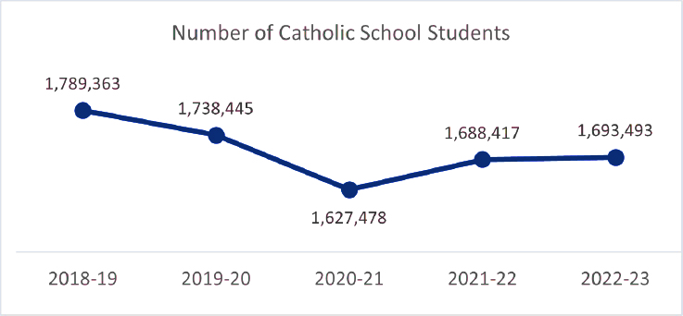
Utilizing Porter’s Five Forces Model to assist Geni Zone in prioritizing strategic initiatives for Catholic schools
Catholic schools in US: 4,812 elementary schools and 1,169 secondary schools with 1.6 Million students
Traditional textbooks, workbooks, and teaching aids commonly used in Catholic schools
Other AI-generated educational platforms
Develop their own educational materials and curriculum in-house
Bargaining power of suppliers
Geni Zone's content suppliers may encompass creators of educational materials tailored to Catholic curriculum.
Bargaining power hinges on factors like the uniqueness of their materials, reputation within the Catholic education
Threat of
Substitut-ions
Threat of new entrants
Platforms with an existing user base and data
Strong ties to local communities, including religious organizations, families, and alumni network
Strong brand recognition and a loyal base of students, parents
Bargaining power of buyers
Less influence over the overall market demand
Virtual collaborates with U.S. dioceses to create K-12 online academies which have strengthen their position and influence the adoption of online education
Rivalry
Large number of AI based free website and learning tool
Moderate variety of businesses
Low switching costs between other competitors
6.4% decline in enrollment
Geni Zone should leverage its economies of scale and pricing strategies to reduce industry rivalry and mitigate the risk of new entrants and substitutes
Champaignnews; Linkedln
Notes:
Sagnika

Slide 20


Applying Porter’s Five Forces Model to Non-Catholic Schools to consider the profitability for Geni Zone
Threats of New Entrants
Threat of Substitute Products or Services
Market size is stable
Non-Catholic has more enrollment for combined schools(primary+secondary)
Focus on interaction within a small class size
Traditional face-to-face teaching
Learning management system: a software tool to create, deliver, and report on training courses and programs
Interactive whiteboard (IWB): a large interactive display smart board
Rivalry Among Existing Competitors
New market based on the religious schools (Ex. A new design of a massive open online course (MOOC) about the learning of Islam and Muslims online)
Some platform to learn languages with religious story with videos (Ex. One4kids is an animation company that focuses on producing entertaining and educational animated films)
Bargaining Power of Suppliers
Bargaining Power of Buyers
Educational technology firms’ bargaining power is flexible
Focused by few suppliers
Market is still developing
Integrate cultural background to customize the learning process
Buyers’ choice to use technology or traditional teaching
Students and teachers have access to technology(Ex. Computers)
Tend to incorporate new technology
Key Takeaway
Market size is stable and profitable to enter
be adaptable for combined schools and small class size
Bargaining power of suppliers is strong since schools tend to use productive technologies
Focus on integrating the language learning practices with cultural background, like with religious stories
From a survey in Illinois, 120/180 principals reported in every classroom there’s a computer
Teachers reported that productivity, research and communication techs are the most helpful with 67.4%, 53.9% and 53%
Non-Catholic market is profitable to enter if Geni Zone could provide adaptable and helpful techniques satisfying teachers and students’ demands
Ebscohost; NCES
Notes:
Coco
https://web-p-ebscohost-com.proxy2.library.illinois.edu/ehost/detail/detail?vid=0&sid=55a22374-b3a1-4749-b122-0d279e0659ae%40redis&bdata=JnNpdGU9ZWhvc3QtbGl2ZSZzY29wZT1zaXRl#AN=147810883&db=asn
https://search-ebscohost-com.proxy2.library.illinois.edu/Community.aspx?community=y&ugt=723731863C9635873796356632853E5228E360D36713629369E320E334133603&authtype=ip&stsug=Am7Yi7jxpoe6ERVbfC_z4a-DGoYW8c44OQj5NBYN0DF2vzEqBbUiKf2bGDMb7q1YqlAszKpL4moUzBM4hryXfOwXQxhhKpmSFDgoH77Bqa8l4EohH_xorkSOUsj3rXblfp5PXPGt7hLsJhu8N4bKSl1jMqgitMU1eIIYn7NOCsHuEt4&IsAdminMobile=N&encid=22D731163C1635973766355632353C673813303377C372C379C370C374C376C370C331&selectServicesToken=A24MjJhVrdyIN0qd3FCYtdsOBs6RkrR63_YBv82v8Iprl-oWdz2fCMFw-W2vkn_CqlsHLDfO-f4ugTMphri8Sz7lB_4NGjuyKOeMLMS3tvYPL90Lej9IfU68Vc1Rg9g1Xow2cq3UiKSSlkoO0u5kwhZpKTBC4TVY06Vgx460qwGrf9AqT3QqBzvBhP4FMsO2cd0ZuhwLwswoocATpq_KNcmYaZAmS6CI3J2l5PDZNS63YxWLEvQz8G-kzZl9t29z4P_dO6cEysiuoWJjF1gjg6B0JaKVusY#db=eoah&AN=20263190
https://nces.ed.gov/programs/schoolchoice/ind_03.asp
https://nces.ed.gov/programs/coe/indicator/cgc/private-school-enrollment

Slide 21
Analyzing the landscape and market size of AI tools in charter schools
Rivalry Among Competitors
Threat of New Entrants
Bargaining power of buyers
Fast growing industry and large number of existing products
EdTec Inc. provides specialized services to charter schools in technical development and back-office handling; strategic partnership with them is crucial and allows access to a large network of charter schools
School regulations decided by internal board and PTA; held accountable by state for test scores and overall performance
Focus on innovative teaching methods, adapting to learning styles of students
Additional focus of instruction in English and comprehension; benefits Geni’s product
Regulations vary by school and by state; CA and IL are moderate while KA and IO are more strict​
Charter schools are subjected to higher budget constraints; receive 22% less funding per pupil than public schools
Will opt for products that are customizable and have the most uses, while maintaining low price; Geni need to expand product scope to compete
Threat of Substitute products
Bargaining power of suppliers
Generally use blended or non-traditional teaching methods in classroom such as gamification
Technologically oriented and prefer using new educational resources and learning materials, alternate ed-tech platforms
Charter schools blend elements of both public and private schools
They receive funding from the state but have operational autonomy bar certain baseline regulations
Enrollment in charter schools exceeds 60496 in Illinois
Bargaining power for suppliers hinges on product variation; advantages are lack of market saturation for charter schools and low price of Geni’s product
Partnerships with groups such as Charter Schools USA and Illinois Network of Charter Schools are essential
Geni must strategically align itself with the unique needs of charter schools in Illinois, to offer cost-effective, customizable features tailored to their focus on innovative teaching methods, english instruction, and rapid improvement goals
CDWG; CharterSchoolsUSA; CRPE; EquipForEquality; Franzczek; ISBE
Notes:
Raghav

Slide 22
Marketing Research
Section #5

Slide 23
Identifying potential online marketing channel for Geni Zone's operation
Effectiveness & improvement
Pro & cons
Not effective since people will either delete your email without reading it, or they’ll mark it as spam
Harder communication since you have no relationship with your audience yet & lack non-verbal feedback
CONS: Risk of being marked spam
Annoying for recipients; intrusive by recipients who receive too many emails
Cold emails often have low response rates
Cold emailing
Use Attention-grabbing subject lines to make sure it doesn’t sound like a direct sales pitch
Keep it short – People are busy & make your point clear in just a few lines
PROS: Cost-effective, reach wider audience & more details can be included
An email waits on the recipient. recipients can read your message when they’re ready
Measure
Tailoring message and content
Competitors marketing channel
Open rate: This metric indicates the percentage of recipients who open your cold email
Click-through rate (CTR): Measures the percentage of recipients who click on links within your email
Understand audience: Demographics, preferences, pain points, and behavior on different platforms
Channel selection: Social media, email, website, and mobile apps
Optimize for mobile: Use a mobile-friendly design, keep the text short and to the point
Platform-specific messaging: Visuals for social media, personalize subject lines & clear CTAs for email
Feedback loop: Listen to your audience and engage with comments, reviews, and messages
Word of mouth advertising (WOMA)
Search engine marketing: Ads on search engines like Google, Bing, or YouTube
Social & display ads: Facebook, Instagram, Twitter, LinkedIn or TikTok kind of Ads
Direct sales: Business-to-customer marketing channel
Geni Zone should focus on regular monitoring, measurement, and adaptation based on performance metrics to optimizing the marketing mix over time
Datatobuz.com; Linkdln; Mckinsey;saleshandy.com; Warrior.forrum
Notes:
Sagnika

Slide 24
Analyzing and providing strategies for digital marketing in the social media landscape
Social Media Marketing Channels
Facebook Marketing Strategies
Entering the market
Bargaining power of buyers
13.58% for standard image ads
17.9% for demonstrative video ads
74.3% click ratio in Facebook ads placed in news feeds
Facebook/Instagram
Suitable for reaching a broad audience, including parents, teachers
Offers options for targeted advertising and community engagement through groups
Conversion Rate
% of new customers brought in via Facebook
Ideal for visual content such as images and short videos
Appealing to younger audiences, visually engaging educational materials
TikTok
$500 initial ad campaign
Impressions (People who view the ad) – 71428
Clicks (People who visit the website) – 642
Conversions (People who decide to purchase) - 83
Market Reach
Youtube
Useful for long-form content, tutorials, and demonstrations
Helpful for both students and educators
Barriers to entry
Takeaways and Initial Steps
Great for professional networking, showcasing expertise
Forming partnerships within the education industry
LinkedIn
Short Facebook ad campaign to gauge future viability for marketing
Demo video and product marketing video on Youtube for new users
Updates regarding new features and product deals on X.com
X.com
Useful for sharing timely updates, educational resources
Engaging with the consumer base, effective for quick communication
Geni should utilize a combination of marketing strategies with Facebook/Instagram, Youtube, and X.com to expand product reach and attract new users
CreativeMarketingLtd; Edisonos; Facebook, Localiq; SproutSocial; Zenobyte.com
Notes:
Raghav

Slide 25
Referring to competitors’ practice helps Geni Zone identify offline marketing strategies
Competitors’ Actions
Geni Zone’s Next Steps
Set up booth in some in-person expos and events to promote its K-12 program for 2-3 times per year
Expos: Association for Career & Technical Education (ACTE)’s Best Practices and Innovations in CTE Conference, National Consortium for Health Science Education (NCHSE) 2023 National Health Science Conference)
Build brand authority by volunteering at professional educational bodies to expand network
Example: Association of Technology Leaders in Independent Schools (ATLIS)
Sign up industry expos by submitting forms
Example: National Catholic Educator’s Association(NCEA)
Pearson
Host teacher innovation competition and award participants with prize
Hold series activities for school principal and executives
Content: Demo bar, Workshops given by both featured keynote speakers and participated K-12 teachers
Highlight: Fireside chats with speakers and FACTS executive boards in more intimated spaces
Host English storytelling club and design customized certificates for participated students to build brand affinity
Send printed flyers and seasonal postcards by mails to K-12 teachers and administrators to arouse their interest in Geni Zone
FACTS
Quantitative Metrics to Analyze Feedback
Conversion Rate Optimization (CRO)
Cost Per Lead (CPL)
Cost Per Mile (CPM)
Customer Lifetime Value (CLV)
The number of purchases divided by the total number of visitors to the event , measuring the percentage of users who responded to the call to action
The total marketing cost divided by the number of purchases, measuring how much a customer will pay for a sign-up
The total marketing cost divided by total number of visitors, measuring brand awareness
How much a customer is worth over their business relationship with Geni Zone, and it grows with time as the customer trusts and goes back for purchases
With existing talent resources, Geni Zone could establish promotional methods that show more customized service and human cares for target customers in local market
FACTS; LinkedIn Learning; Pearson; Shopify
Notes:
Xiaolei
Association of Technology Leaders in Independent Schools (ATLIS): https://theatlis.org/page/volunteer-form
National Catholic Educator’s Association(NCEA): https://nationalcatholicedu.iad1.qualtrics.com/jfe/form/SV_3kZWzhBERLIrgUK

Slide 26




Performing research on offline marketing to understand which channels are most effective in the EdTech industry
Offline Marketing Channels
Offline Marketing Strategies
1
Educational Trade Shows
Offline Marketing Value
Reach
A form of long-term investment that can lead to direct sales and long-term partnerships
Illinois Education & Technology Conference (IETC) is an example that focuses on integrating tech into education
39% of marketers recognize offline campaigns as vital
Partnerships with educational institutions to co-host seminars
2
Direct Mail
Indicates their effectiveness in building loyalty
Particularly schools that value traditional engagement methods
Direct engagement with core audience
Offline channels impactful, trusted by 82% of consumers
Direct mail campaign can cost $0.30 to $2 per piece
Response rates for direct mail in education sectors often surpassing 4-5%
3
Print Advertising
Integration with Digital
Direct Mail Efficacy
Ads in educational magazines or journals can range from ~100 to 1000+ dollars
Trusted by educators, with niche educational magazines having a high readership loyalty
68% of marketers plan to extend offline strategies to TV
High open rates at around 80-90%
4
School Partnerships
Demonstrated high long-term success rates
Offers a pathway to user feedback and product validation, with low direct costs
This demonstrates the potential for synergistic online-offline campaigns
Easier to transition from offline to online
76% of consumers trust direct mails when making purchasing decisions
Results to more efficient targeted marketing
Geni Zone can amplify its market presence and trust in the education sector through strategic engagement in trade shows, high-impact direct mail, and print advertising
mycodeless
Notes:
Stanley

Slide 27


Identifying creative ways of offline marketing and metrics of effectiveness that Geni Zone could utilize
Effective Ways
Creative Ways
Metrics of Effectiveness
Cost-saving:
Educational Associations: organize events to showcase technology
Utilize Low-cost Publicity: through local media outlets(Ex. community newspapers, magazines, and newsletters)
Education Conferences: Reach diverse educators, and demonstrating technology's applications with interactive experiences offered (Ex. Illinois Education and Technology Conference (IETC))
Interactive Workshops: Organize training sessions for teachers, parents, and students to experience AI-powered platform firsthand
Offline Competitions: Organize competitions related to English learning, where students can participate individually or in teams
Unique Discount Codes: Assign unique discount codes (Ex. direct mailers, print advertisements)
Call/Mail Tracking: Unique phone numbers/e-mails and track the number of calls/e-mails received
Surveys and Feedback: Conduct surveys to understand consumers’ awareness (Ex. in-person interactions, mail-in surveys)
Brand Awareness Studies: Compare data from pre- and post-campaign surveys to measure the impact on brand recognition and perception
Time-saving:
Collaborate with Schools: to organize workshops for teachers, parents, and students
Both:
Educational Conferences: fast to tell target consumers Geni Zone’s benefits with low cost
World-of-mouth Marketing with Incentives: parents, teachers are encouraged with discount to recommend to others (Ex.2 more users /15% off)
Takeaway
Creative marketing ways: customers’ experiences and leave deep impression
Effective ways: low-cost local educational conferences and world-of-mouth marketing with incentives
Metrics need to be measurable, like amount of discount codes used, call/mail tracking, surveys/feedback, and brand awareness before and after a period
Geni Zone could utilize low-cost local educational conferences and world-of-mouth marketing with incentives as effective offline marketing ways, and use measurable metrics to measure the impact
Ebscohost; LivePlan; Shopify
Notes:
Coco
https://web-p-ebscohost-com.proxy2.library.illinois.edu/ehost/detail/detail?vid=5&sid=07c05452-c4a8-4097-8f80-01af962fac2b%40redis&bdata=JnNpdGU9ZWhvc3QtbGl2ZSZzY29wZT1zaXRl#AN=102658282&db=bsu
https://www.liveplan.com/blog/10-effective-offline-marketing-ideas-for-startups-in-2015/
https://www.shopify.com/enterprise/blog/how-big-brands-rock-offline-marketing-strategies#2

Slide 28
Promotional Strategy
Section #6

Slide 29



Utilizing promotional strategy makes Geni Zone able to attract more potential customers
Pros & Cons of Promotion
Review Incentive
Encourage customer to make positive review on third-party directory platforms by providing benefits
Examples: G2, Capterra, Yelp
Story Collection
Compose customer’s story and using experiences with their names and photos
Referral Gamification
K-12 schools share related posts on their official accounts in social media, and award cash return to those win the challenge with posts of most likes/forwards
Close connection with customers by deeper engagement
92% consult online reviews when purchasing;
88% trust online reviews as much as personal recommendations from friends
Effective to expand corporate influence in the community by social media, organic search, and content marketing
Pros
Testimonials
Practice
Referral Program
Partner Discounts
Offer bundling sales discount and premium services with the customer of Geni Zone’s business partnerships
One-time coupon with hard deadlines
Additional 15 hours of onboarding support on implementation
6-month checkup on system operation
Customized brochures in email created by email service provider (Mailchimp, Hubspot, Marketo, Pardot) with useful insights in solving customer’s pain point
Give existing customers a referral code to share with their friends or relatives
New customers: Discount for their first purchase from existing customers
Existing customers: Receive rewards which can incentivize them to actually recommend Geni Zone
Conference Booth
Sign up for exhibition in Expos held by professional bodies to strengthen in-person connections with target audience
Demo bar with free trial for 1 academic year
Workshops providing training of using learning management system for teachers
Over-promotion may have side effect on customer perception
Paid ads are expensive on main-stream social media ($500 initial ad campaign)
Cons
Key Takeaways
Leveraging these strategies could pinpoint to potential customers with higher conversion and increase retention rate effectively
Upgrading traditional promotion strategy with innovative methods allows Geni Zone to explore new opportunity in educational technology industry
Hubspot；Popupsmart; Verizon Business; Yelp
Notes:
Hubspot: https://blog.hubspot.com/sales/sales-promotion-ideas
Popupsmart: https://popupsmart.com/blog/how-to-use-testimonials-in-marketing
Verizon business: https://www.verizon.com/business/solutions/public-sector/education/k-12/
Yelp: https://business.yelp.com/partners/guides/diversification-marketing-vs-specialization-for-agencies/?utm_medium=search&utm_source=type%3Aclaim_ad_google&utm_campaign=Non-Branded_Paid-Claim_Promote-Business&utm_content=TopAG&utm_term=best%20way%20to%20promote%20my%20business&gclid=CjwKCAjwh4-wBhB3EiwAeJsppLSZ4i04wi59eeXNy-sDSjidPL1-I9JNZSwtcyQkM9iJY-053RUBPBoCax0QAvD_BwE

Slide 30
Content Marketing – Facebook & Youtube

Slide 31

Formulating a marketing strategy for Geni with special consideration for Facebook
Facebook Marketing Strategies and Outline
Bargaining power of buyers
Entering the market
Set clear goal prior to posting (Ex: Finding 500 new users withing 6 months)
Optimize visuals in ads, push user-friendly appeal to parents and educators
Highlight adaptability of Geni Zone for students’ unique needs in ads
Capitalize on low cost of Geni and high integration with ed-tech platforms
Threats and Takeaways
Barriers to entry
Ad Fatigue: Ads need to be regularly modified when response rate and conversion rate goes down
Negative Feedback: Negative feedback or comments can damage brand reputation and credibility; prompt and concise responses that solve user problems are crucial
Overall Threats: Consistently monitor ad performance to determine feasibility and sustainability of running ads, pull ads and change strategy if losses outweigh benefits
Limit text to a few lines, focus on iconography and provide links in posts
Post 1-2 unique ads per month to minimize spending and maximize engagement
Geni should keep the aforementioned considerations at mind prior to running ads on Facebook, and must consistently check analytics to determine the sustainability of Facebook ads
CDWG; chatdesk.com; creatosaurus; roiminds; thinkorion; webfx.com;

Slide 32
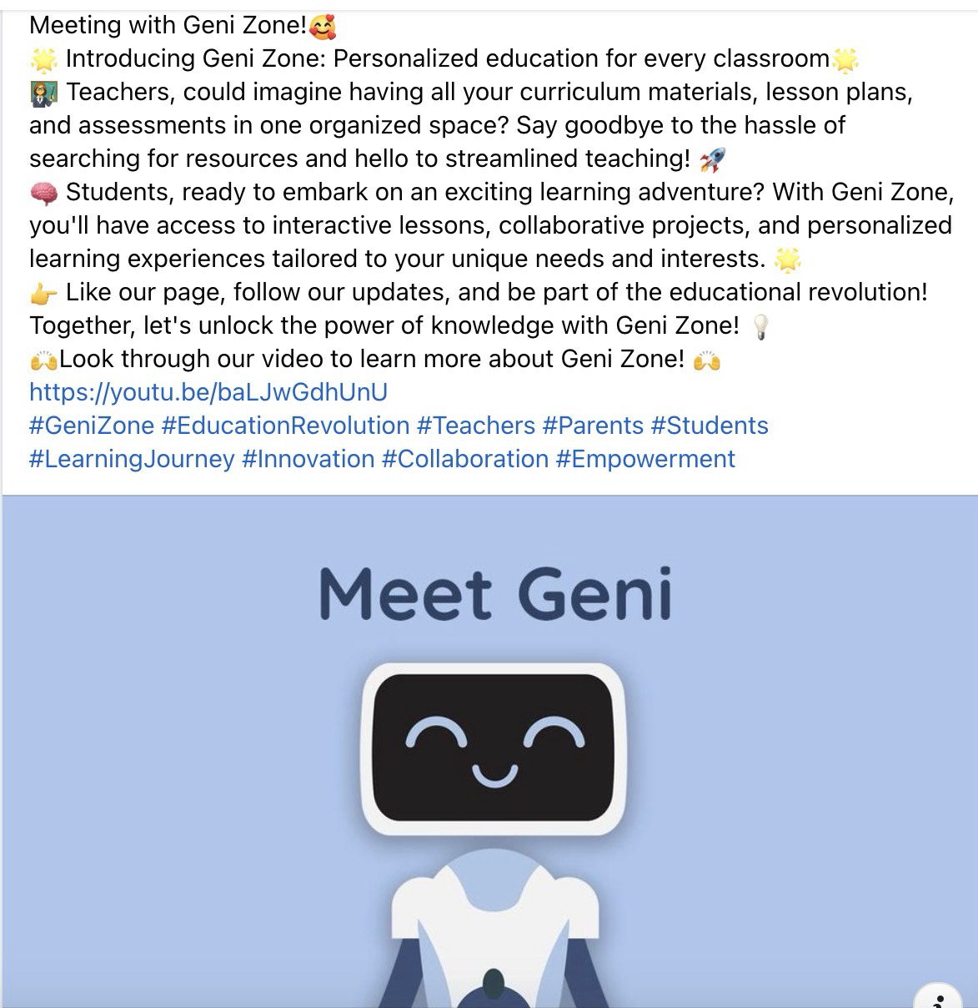

Slide 33
Utilize YouTube Videos to Increase Potential Users of Geni Zone
Types of Videos
Boost Engagement
Trend & Frequency
Entering the market
Bargaining power of buyers
Marketing Video: Video displaying the purpose of the tool, use-cases, development of the tool, pricing, and features; can be uploaded to YouTube and used for Facebook marketing as well
Demonstration Video: Video to demonstrate product functionality, features, and different aspects of the tool, along with integration with other EdTech platforms; to be uploaded to YouTube as well as the product website;
Can mention in videos (end screen):
X.com: Sharing updates with regard to app downtime, new platform features, answering common queries
Company Blog: Sharing user stories and fun facts, increases overall customer engagement at minimum cost
Links of Facebook and other social media customers can follow
Once a Week
Mon | Tue | Wed | Thu | Fri | Sat | Sun
2-4pm | 2-4pm | 2-4pm | 2-4pm | 2-4pm | 9-11am | 9-11am
Friday 3-4pm
Keep openings short
Add an interesting hook
Use channel analytics and improve future videos based on previous data
Add end screens to promote videos, channel, or website
A series of videos: Maintain to update a series of videos for one topic, like introducing how to use each tool of Geni Zone
Length: Don’t make videos too long
Engagement: Don’t ignore Feedback, actively encourage feedback from viewers and respond to comments or questions
Copyright Property: Respect the intellectual property rights of others, and avoid using copyrighted images, music, or video clips without proper licensing
Takeaways
Barriers to entry
Make a series of videos demonstrating functionalities
Maintain to update once a week on Friday 3-4pm
End Screen: link related materials customers can follow, encourage feedback
Analyze data by channel analytics for improvements
Don’t be too long and add a hook to be appealing
Do’s
Not
Do’s
Geni Zone could consider posting videos constantly every Friday 3-4pm demonstrating functionalities, and designing videos to be appealing to encourage feedback
Buffer; SocialMediaExaminer; WordStream
Notes:
https://buffer.com/resources/best-time-to-post-on-youtube/
https://www.socialmediaexaminer.com/15-tips-growing-youtube-channel/
https://www.wordstream.com/blog/ws/2023/08/08/best-time-to-post-on-youtube

Slide 34
Content Marketing – Cold Emailing

Slide 35
Researching key strategies and statistics needed for effective cold emails
Helpful Guidelines
Engaging Content Types
1
Visual Elements: Use brand colors, a clean layout, and relevant images to catch the eye
Benefit-Driven
Personalized
Question-Based
Highlight the immediate benefit or value to the recipient
Emphasize outcomes or results that the recipient can expect
Tailor the subject line to the recipient's specific role to indicate that the email content is crafted just for them
Questions can provoke thought and encourage recipients to open the email for answers or solutions
2
Subject Line Engagement: Highlight the importance of personalized, intriguing subject lines to boost open rates
3
Content Relevance: Emphasize tailoring content to recipient interests and timely matters for increased engagement
Related Statistics
4
Inclusions: Briefly mention the inclusion of engaging materials like brochures or interactive links
Sending follow-up emails can more than double the response rate
Emails with a single, clear Call-To-Action can increase clicks by 371%
Emails with personalized subject linked are 26% more likely to be opened
Studies suggest that emails sent on Tuesday, Wednesday and Thursday have the highest open rates, particularly if sent around 10 AM or between 2 PM and 5 PM
Emails containing visual elements like images or videos can increase click rates by up to 300%
5
Feedback Mechanism: Suggest including a simple feedback tool, like a survey link, to gauge recipient reactions and gather insights
6
Response Enhancement: Brief strategies to encourage recipient interaction, such as clear CTAs and follow-up prompts
Geni Zone should craft their cold email approach with concise, personalized content and compelling subject lines, tailored to meet the specific needs and timing of educational institutions
Content Marketing Institute, HubSpot Research, Mailchimp
Notes:
https://research.hubspot.com/
https://mailchimp.com/resources/research/
https://www.campaignmonitor.com/resources/
https://contentmarketinginstitute.com/research/
https://www.marketingprofs.com/marketing/library/

Slide 36
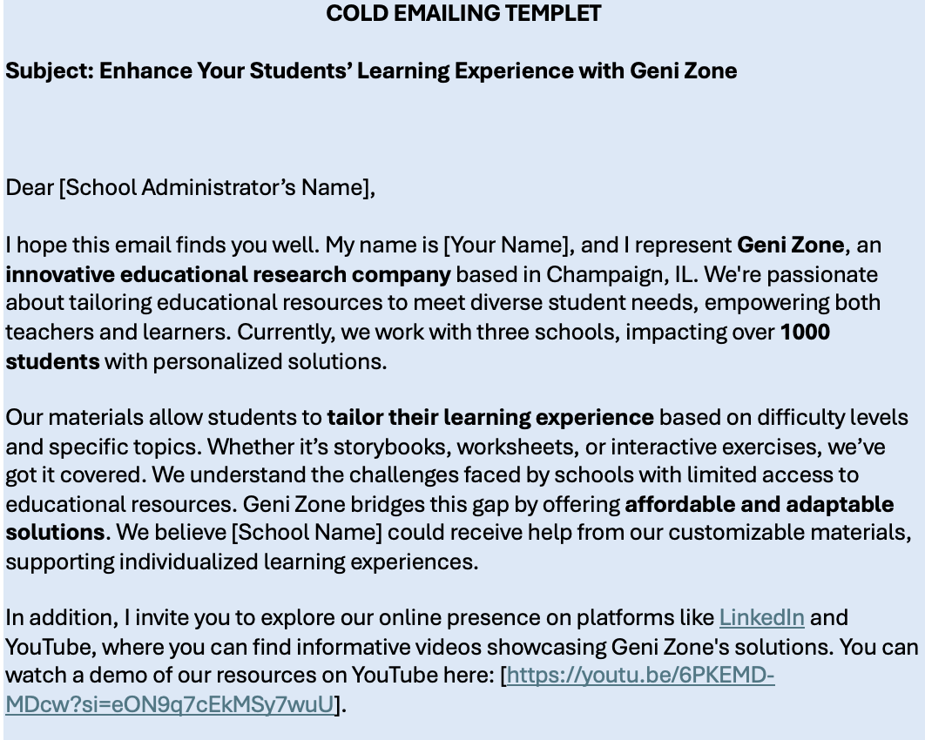
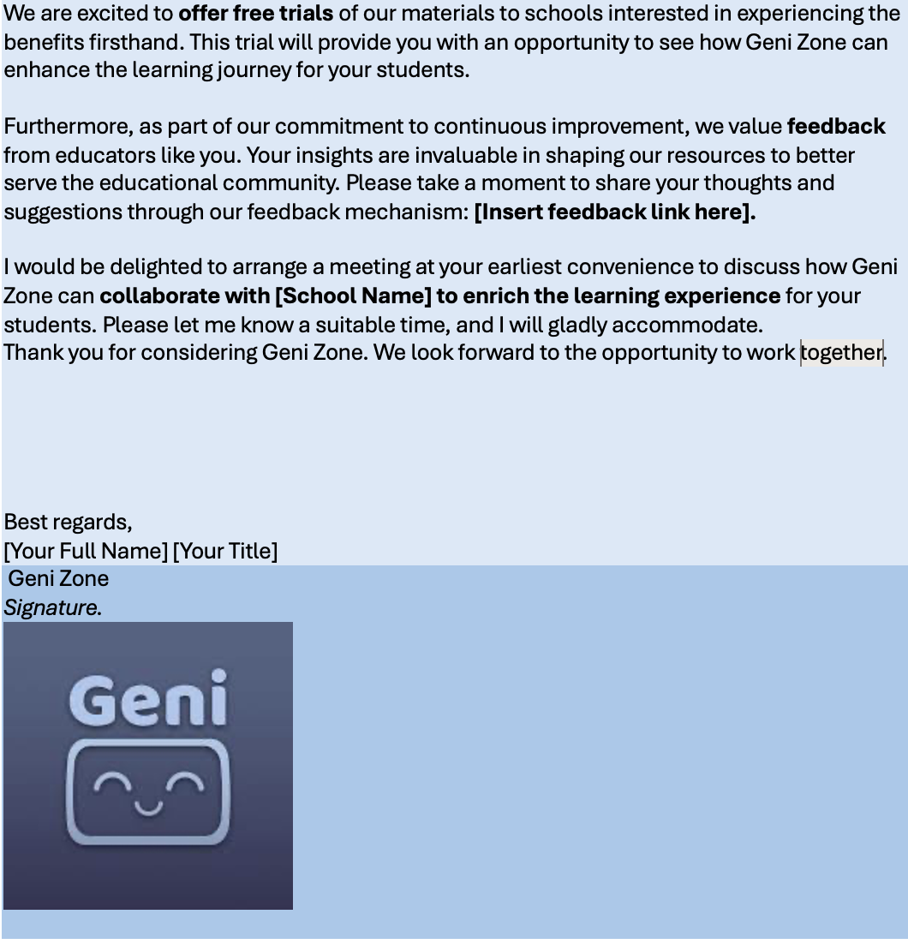

Slide 37
Primary Research
Section #7

Slide 38



Drawing insights from the interview with Michelle Nelson to provide Geni Zone with next step suggestions
Interviewee Overview
Background
She is a Professor of Advertising and the department head
Nelson studies and teaches advertising and consumer research, She has published nearly 70 peer-reviewed articles
Insights
Next Steps
Advertisement
Recommendations
Teachers embrace more traditional media values
Different demographics prefer different advertisement platforms
Adapt different advertising strategies for varying demographics: Different age groups are accustomed to different apps and platforms, so the demographic should always be the first factor considered
Advertising should be done by region: The local (Champaign-Urbana) news is a good starter, with affordable prices
Connecting with school faculty before cold emailing: Will sky-rocket chances of a partnership, especially if a referral was earned; this can be done by connecting on LinkedIn prior to emailing
A educational expert is needed: Product needs to be backed by educational research & evidence and ISBE standards must be met before any school will lay eyes on our product; It is vital that our partners know that the product fits the state and federal numbers, this includes the syllabus and course content
School Partnership
Building a relationship with a school faculty member first will lead to referrals
A few of the have children in local private schools
Brochure & Product
The product needs more explanation first
Brochure is hard to comprehend due to the wordy nature
Include testimonials to increase trust
Tailor ads to demographics, partner with educators, and align products with academic standards for trusted educational solutions.
Nelson

Slide 39
Customer Persona
Section #8

Slide 40


Creating Persona of Elementary Students Provides Customer insights for Geni Zone
Attitude
Not know much
8% know a lot about education technology
But still willing to accept
64% think education technology will help them in future careers
72% want to use AI tools in education if more guidance are provided
“We want to…”
Keep up with the changing world with access to technology educational method
Have fun in study while improving learning effectiveness
Develop learning habit by instilling a lifelong love of learning and curiosity
Challenge
Distraction
Reliance on education technology may have negative effect of their ability to focus
Lack practice of social skills
Get used to being alone to solve problem, thus not engage in face-to-face communication
How to Solve
Add gamification program with interesting features
Meet need for competency: Improve the content of material with science knowledge
Overcome challenge of distraction: Limit use time by setting specific conditions
Cooperate with parents and teachers to hold English storytelling club
Overcome challenge of social skill: Create interactive hands-on group activities
Interest
Need for entertainment
Need for competency
Need for relatedness
Alex & Bella
Elementary School Students
Age: 4-11
Location: Urbana-Champaign
Tool in curriculum: FACTS
Role: Main user of education technology
For Geni Zone, it’s important to take advantage of main users’ demand and behavior, and solve pain point by combined consideration of interest and challenge
Bloom Tampa Bay; Charles Nechtem Associates; National 4-H Council; The74; Technology Teaching Resources with Brittany Washburn

Slide 41



Creating a unique high school student from Illinois persona for Geni
Math and Reading
Jake’s Wishes
Student and Teacher Ratio
61% in Math Proficiency
64% in Reading Proficiency
NNHS with a 14:1
Indicative of the level of individual attention students will receive
College Application Assistance
Gamification
Collaboration Features
Progress Tracking
Language Support
Personalization
Graduation Rate
Content Preferences
97% in Naperville Public High Schools
>99% in Naperville North
Jake
High School Student
Turns to Social Media, educational forums, and peer recommendations for EdTech insights
Age: 16 years old
Gender: Male, Cisgender
Location: Naperville, IL
School: Naperville North
Background:
1st generation immigrant from Korea
Diverse interests for English and creative writing
EdTech Usage
Tech Assistence
75% of time studying, Edtech is used to enhanced learning
Illinois high school students shows a 30% higher engagement in creative writing tasks when using EdTech tools
Geni should blend personalized learning and college prep features, ensuring engagement and support for Illinois high school students' academic and future career paths
Public School Review

Slide 42




CREATING A PERSONA OF HIGH SCHOOL PRINICIPLES
Challenges
Want to incorporate web-based learning but not the final decision makers
Providing training for teachers and staff on using web-based platforms is a challenge
Ensuring that parents from diverse backgrounds can access with online resources
Needs
Meet Smith
Teachers don’t have access to strong materials, they search for them online, often leading to inconsistent quality and weak alignment
Platforms for tracking student’s progress and analyzing data
Principals of public high schools
Age: 40-55
Masters degree in education administration
Assist teachers in making the best decisions to meet student needs
SCOPE FOR GENIZONE
Potential to introduce the product
Personalized content for different students
Understanding Smith's strategies, needs and challenges that support effective leadership and enhance overall school performance would help Geni Zone to introduce their product into the school
Bureau of labour statistics; drexel.edu; education.illinoid.edu; soeonline.com

Slide 43

Analyzing the buyer’s side persona for parents of middle school students
Entering the market
Bargaining power of buyers
Goals and Concerns
Parents seek all rounded education for children, comprising every subject area
Innovative learning methods and engagement in classroom to develop social skills; 62% of parents prefer their children to have engagement with technological materials
Personalized learning oriented towards child’s skills and weaknesses
Access to technological resources to prepare students for future careers
71% of parents believe students are over-reliant on technology
97% of parents expressed concern over increasing use of AI in schools
Amanda
Age: 46
Career: Interior Designer
Children: 2 children; 1 in 6th grade and 1 in 8th grade
Location: Naperville, Illinois
Family income: $100,000 p.a.
Takeaways
However, only 12% of parents are against the use of AI in schools, and most parents only believe that stronger regulation is required
Complying with a strict set of regulations and understanding the needs and concerns of parents is crucial since they control the main customer base
An advisory board comprised of parents is a good option to understand their needs
Barriers to entry
Parents in general believe that AI is currently negatively impacting students’ behavior, and with stronger regulation and
Edutopia; Forbes.com; Learner.com; Ptaourchildren.org; Verywellfamily; Visme.co
Notes:
fa

Slide 44
Persona of Public High School Teachers
Profile
Goal of Using AI
Current Platforms
Role: using AI for courses designing, assigning homework, grading, etc
Challenges:
Big class size: too many students compare to private schools
Standardized test: Practice questions assigning and grading
Willing to adopt technologies in class for grading and designing courses
AudioPen: converts spoken words into text
Canva Magic Write: generates ideas and aids in brainstorming
OpenAI: ChatGPT /ChatGPT 4
Quizizz: personalized quizzes and lessons, with adjustments for difficulty and grammar checks
54.5%
45.5%
Average age: 43
New York has the highest average salary
Typically have at least a bachelor’s degree
Decision influencers, while school directors are decision makers
Interests and Needs
Evaluation and Concerns
Takeaways
Advertising:
Workshops and conferences
Social media platforms (Ex. video tutorials)
Colleagues and fellow teachers
Needs:
Alignment with curriculum standards and learning objectives
Differentiation options to cater to many students' diverse abilities
Influence decisions:
School administrators/colleagues/online communities and social media groups
Concerns:
Time constraints for learning/limited access to devices
Evaluate credibility:
Researching product reviews/testimonials
Trying out free trials
Public high school teachers have elder age and more female teachers
They desire AI tools that could save time for designing courses, assigning homework and grading with a relatively big class size
Advertise through conferences, social media and recommendations of colleagues may help
Geni Zone could design technologies that fit a big class size with diverse students towards standardized tests for public high school teachers to save time in assigning and grading coursework
Edutopia; Futurism; GeekWire; USNews; Zippia
Notes:
https://www.edutopia.org/article/7-ai-tools-that-help-teachers-work-more-efficiently/
https://futurism.com/the-byte/teachers-ai-grading
https://www.geekwire.com/2023/reading-writing-and-chatgpt-high-school-english-teachers-adjust-to-the-new-realities-of-ai/
https://www.usnews.com/education/k12/articles/private-school-vs-public-school
https://www.zippia.com/high-school-teacher-jobs/demographics/

